Slide 1
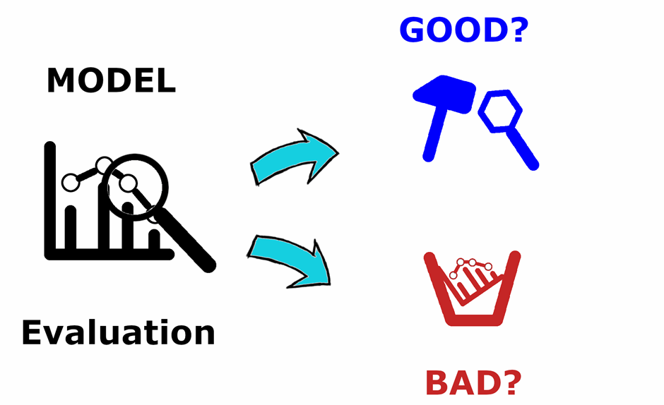

Evaluating Your Model
Notes:
Analyzing the performance of your model

Slide 2

Evaluation Metrics
Explain the performance of the model
Classification Metrics:
Accuracy
Precision, Recall (Sensitivity), F1 Score, AUC-ROC
Regression Metrics:
MSE, RMSE, MAE, R^2
And more:
Clustering metrics, Ranking metrics, Time Series metrics, …
Notes:
The choice of evaluation metric completely depends on the type of model and your implementation of the model

Slide 3
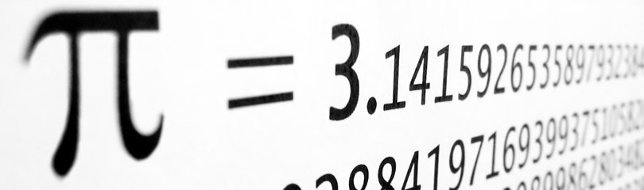
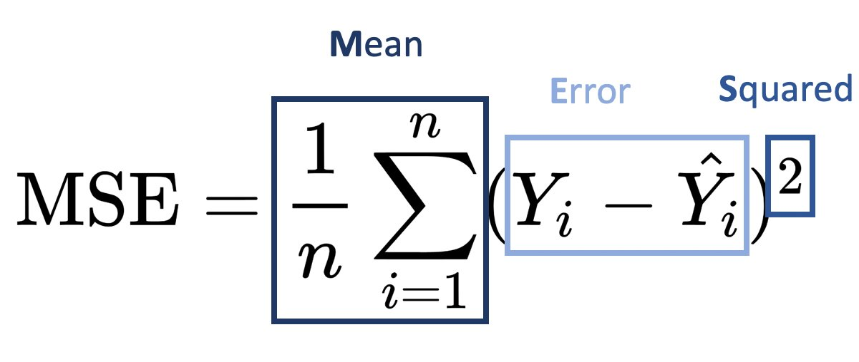
Regression Metrics
What does a prediction from a Regression problem look like?
A continuous value
So my model outputs a number, what now?
Selecting your performance measure
Mean Squared Error:
Notes:
The MSE is the average squared distance between the observed and predicted values.
Squaring the differences eliminates negative values for the differences and ensures that the mean squared error is always greater than or equal to zero.
Only a perfect model with no error produces an MSE of zero.
Additionally, squaring increases the impact of larger errors. These calculations disproportionately penalize larger errors more than smaller errors. This property is essential when you want your model to have smaller errors.

Slide 4

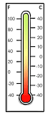
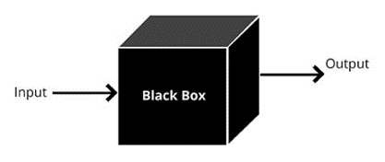
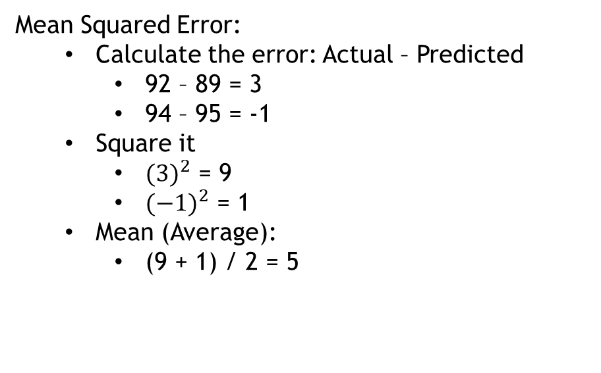
Example:
Your Model
Predicted Temperatures for Sat and Sun: 89°, 95°
Actual Temperatures for Sat and Sun: 92°, 94°
Mean Squared Error:
Calculate the error: Actual – Predicted
92 – 89 = 3
94 – 95 = -1
Square it
${(3)}^{2}$ = 9
${(−1)}^{2}$ = 1
Mean (Average):
(9 + 1) / 2 = 5
On average, the squared differences between the actual and predicted temperatures are 5

Slide 5


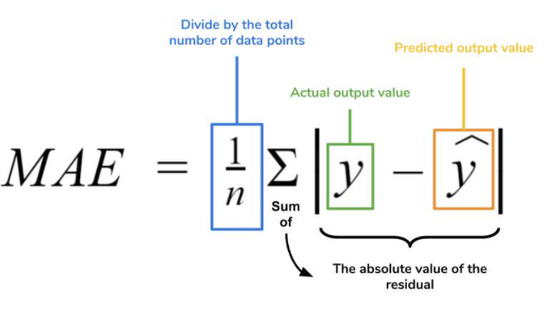
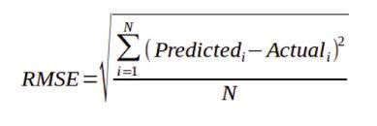
Other Options
On average, the squared differences between the actual and predicted temperatures are 5
2
°F
?
?
?
Notes:
Because it uses squared units rather than the natural data units, the interpretation is less intuitive.
MSE squares the errors, which means that larger errors have a disproportionately large impact on the final metric. This makes MSE highly sensitive to outliers. A single outlier can significantly skew the MSE, leading to an inaccurate assessment of model performance.
MSE may not be the best choice in applications where robustness to outliers is essential. Other metrics, such as Mean Absolute Error (MAE), can be more robust since they do not square the errors and thus treat all deviations more equally.

Slide 6

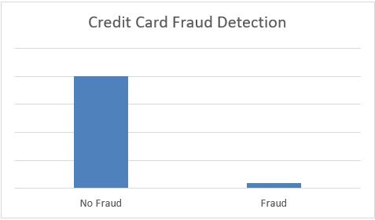

Binary Classification Metrics:
What is the first metric that comes to mind for classification?
Accuracy
The problem with accuracy
95% Accuracy
Input
Fraud or
Not Fraud
950 examples
50 examples
Is this meaningful?
Not really…

Slide 7
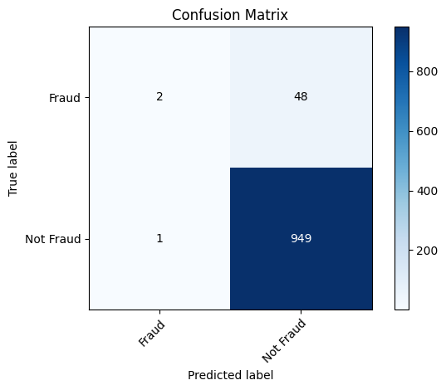
Confusion Matrix:
True Positive
False Negative
False Positive
True Negative

Slide 8
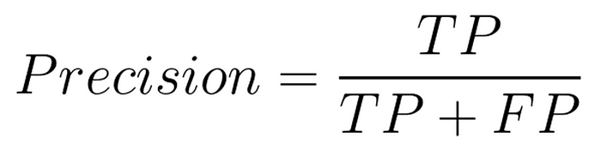
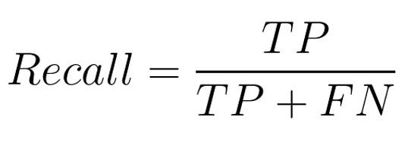
Classification Metrics:
Metrics from the Confusion Matrix
Precision (Positive Predicted Value)
Recall (True Positive Rate)
True Positive
False Negative
= 2/3 = 66%
False Positive
True Negative
= 2/50 =4%
Notes:
Confusion Matrix is not exactly a performance metric but sort of a basis on which other metrics evaluate the results.
Can we use precision as our only metric?
A trivial way to get perfect precision is to only make negative predictions and one very confident positive prediction.
Such a classifier would not be very useful, so precision is usually used alongside another metric

Slide 9
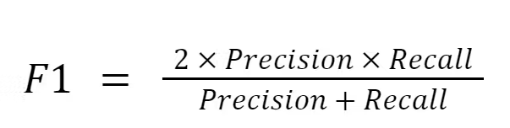
Classification Metrics:
Combining Precision and Recall
F1-Score
signifies if the model can effectively identify positive cases while minimizing false positives and false negatives
Harmonic Mean of Precision and Recall
Gives more weight to lower values
So, it needs large precision and recall values to be good
F1-Score = 1 means perfect precision and recall
F1-Score = 0 means precision and recall are 0
= 7% Not good…
Notes:
It is often convenient to combine precision and recall into one metric called the F1 score
Where the regular mean treats all values equally, the harmonic mean gives more weight to lower values
Classifier will only get good F1 score if both recall and precision are high
The highest possible value of an F-score is 1.0, indicating perfect precision and recall, and the lowest possible value is 0, if precision and recall are zero.

Slide 10
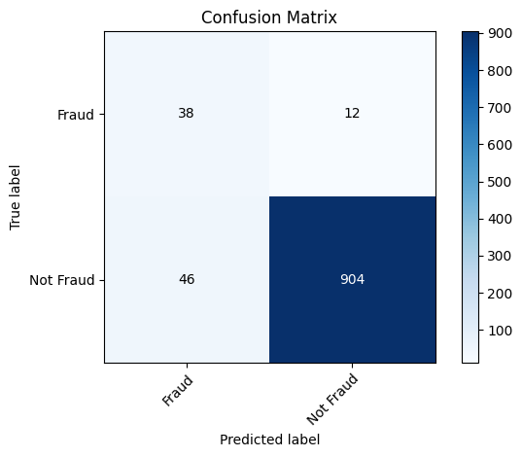
Classification Metrics:
Previous Metrics
Precision: 66%
Recall: 04%
F1Score: 07%
Accuracy: 95%
New Metrics
Precision: 45%
Recall: 76%
F1Score: 56%
Accuracy: 94%
Notes:
Here is the confusion matrix of a new model, which model is better based off of these metrics?

Slide 11
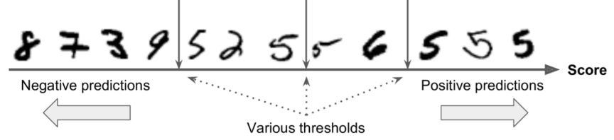
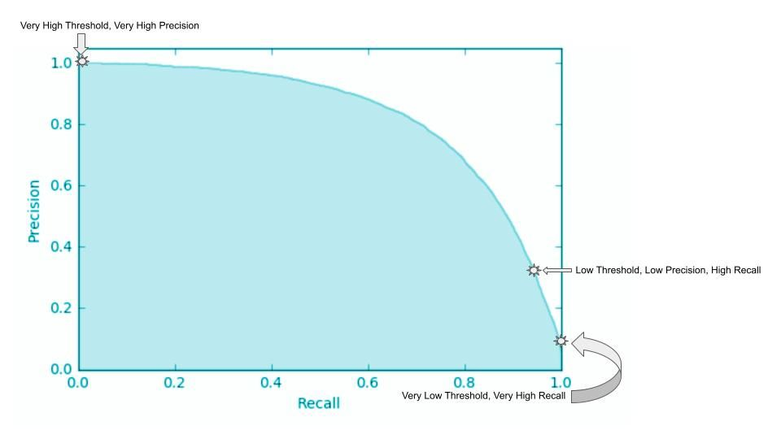
Plotting Precision vs. Recall:

Slide 12
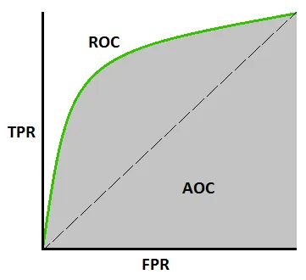
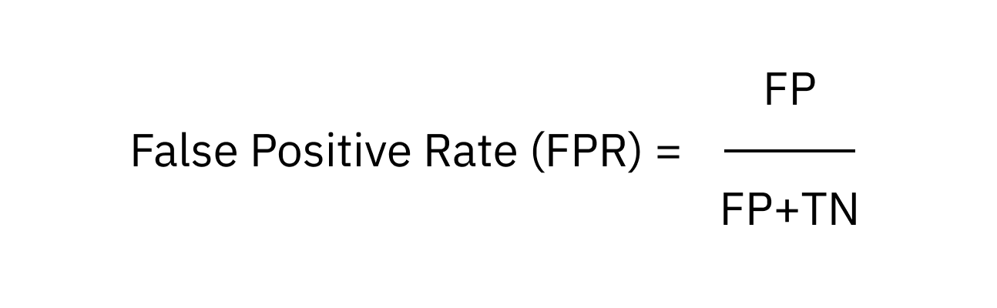
Receiver Operating Characteristic (ROC) Curve
Tell us how much the model is capable of distinguishing between classes
Similar to precision recall curve
Plots recall (TPR) against the False Positive Rate
Area under the ROC Curve (ROC AUC)
A metric
Higher the AUC, the better the model is at predicting 0 classes as 0 and 1 classes as 1

Slide 13
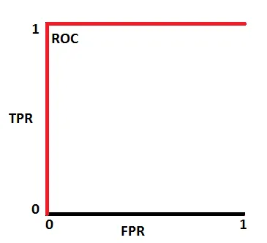
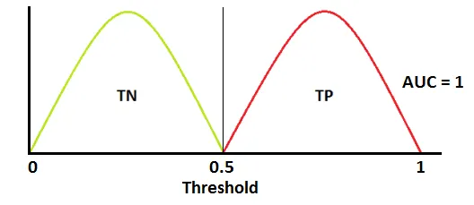
Receiver Operating Characteristic (ROC) Curve
Notes:
This is an ideal situation. When two curves don’t overlap at all means model has an ideal measure of separability. It is perfectly able to distinguish between positive class and negative class.

Slide 14
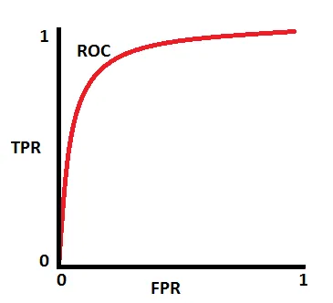
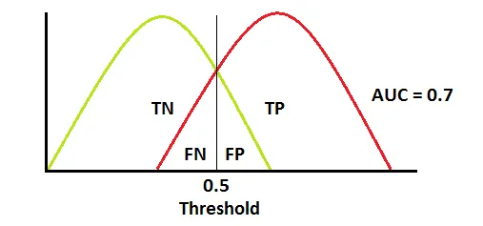
Receiver Operating Characteristic (ROC) Curve
Notes:
When two distributions overlap, we introduce type 1 and type 2 errors. Depending upon the threshold, we can minimize or maximize them. When AUC is 0.7, it means there is a 70% chance that the model will be able to distinguish between positive class and negative class.

Slide 15
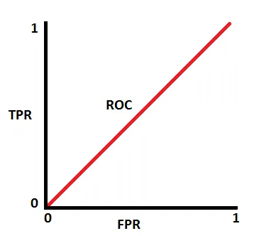
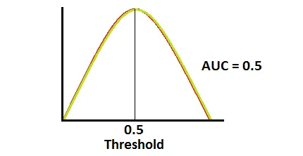
Receiver Operating Characteristic (ROC) Curve
Notes:
This is the worst situation. When AUC is approximately 0.5, the model has no discrimination capacity to distinguish between positive class and negative class.

Slide 16
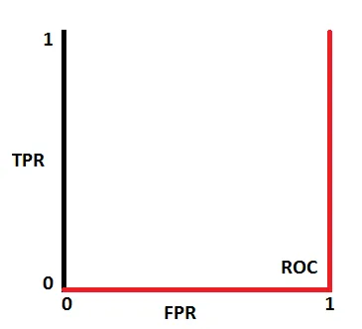
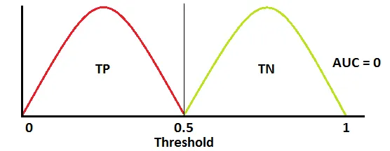
Receiver Operating Characteristic (ROC) Curve
Notes:
When AUC is approximately 0, the model is actually reciprocating the classes. It means the model is predicting a negative class as a positive class and vice versa.

Slide 17
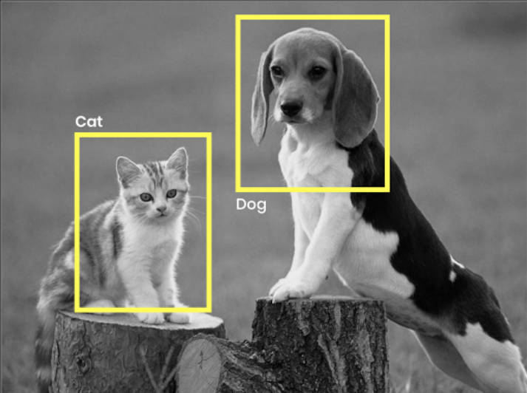

Baselines
Ok, I have a F1-Score/Accuracy/ROC AUC, what now?
You need something to compare it to, a baseline!!!
Your metric is meaningless without context
Common baseline: a dummy model

Slide 18

Questions!

